Slide 1
Introduction to Deep Learning
Aniket Maurya

Slide 2
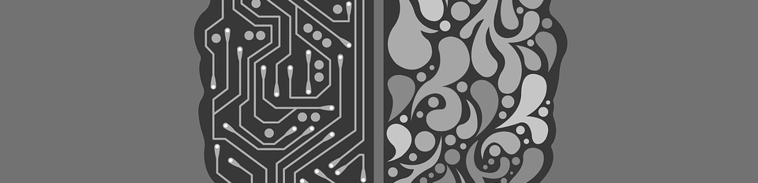
I will discuss
What is DL?
Why is it taking off so fast and suddenly?
Narrow AI and General AI
How does Neural Networks work?
So many frameworks?
Create your own image classifier.
Notes:
Hype or science

Slide 3
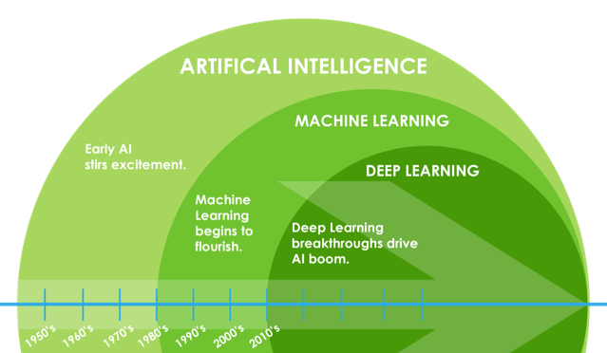
What is DL?
Deep Learning is a subset of ML
Where we deal with a special kind of
Architecture Neural Networks.
(https://www.tensorflow.org/about)

Slide 4
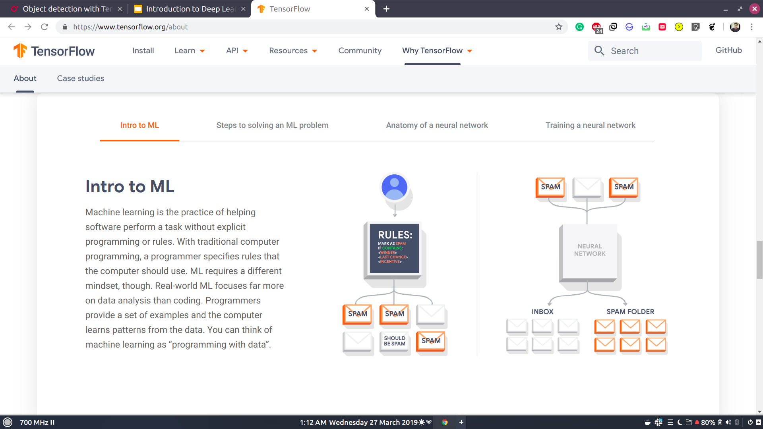
Any ML or DL algorithm recognises a pattern in the data. And predicts output for unseen data using that pattern.

Slide 5
Narrow AI General AI
Narrow AI refers to AI which is able to handle just one particular task.
A spam filtering tool
A recommended video from YouTube.
Google Home, Amazon’s Alexa or Apple’s Siri
A self-driving car
This refers to a system which is able to cope with any generalised task which is asked of it, much like a human.
Sophia, the Robot.
https://drive.google.com/file/d/17MqdWNBQMAG1JwLf8o2W6vCz7xquYlja/view?usp=sharing

Slide 6
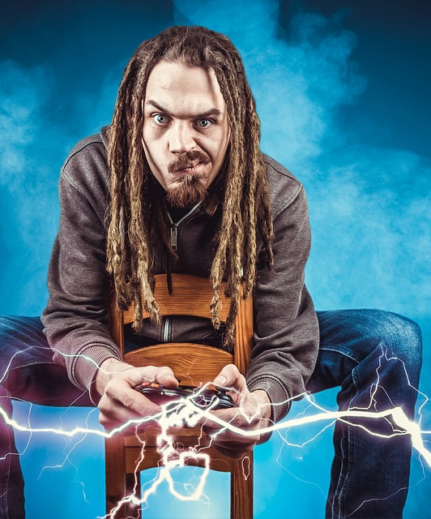
Why is it taking off suddenly?
First Perceptron created in 1958.
Back-propagation algo was created in 1975 by P. Werbose.
But still the development didn’t continued well.
Today everyone knows and want to pursue DL.
Thanks to Gamers and Big data!!
Notes:
due to limitations of hardware

Slide 7
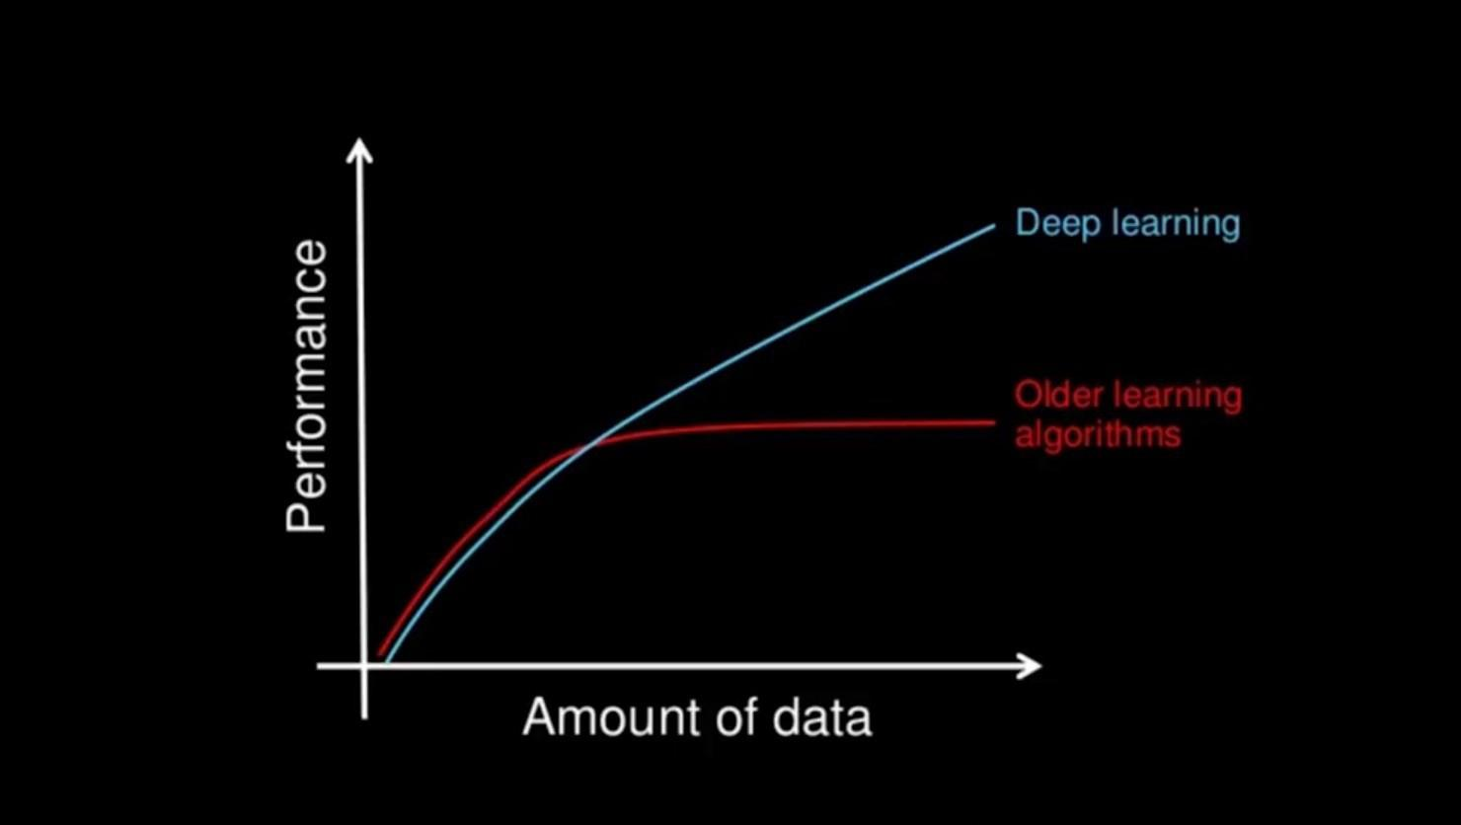
Role of BIG DATA

Slide 8
Is NN related to brain?
Well! No one exactly knows how a human brain does the computation.

Slide 9
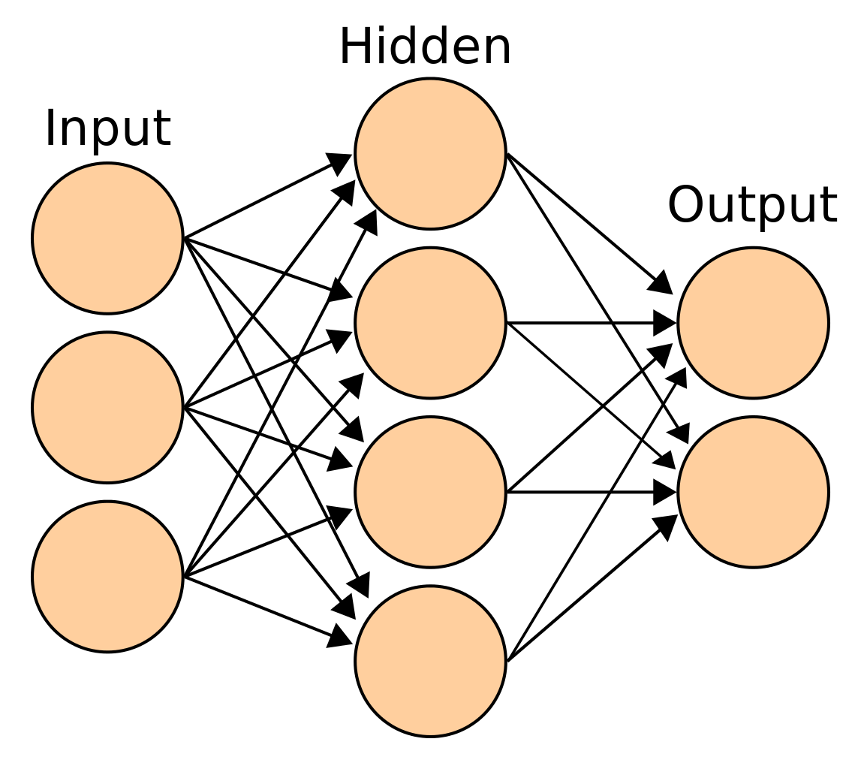
Data is fed to input layer.
Predictions are generated by output layers.
The lines are called weights.
Weights adjust themselves to fit to the pattern of the data.

Slide 10
How does NN work?
Forward-Propagation:
As the name suggest data propagates within the network in forward direction.
Traversal from Input first hidden layer to last (output) layer.
Gradient Descent:
Updates weights.
Backward-Propagation:
Data propagates within the network in backward direction.
Traversal from last (output) layer to first hidden layer.
https://www.tensorflow.org/about

Slide 11
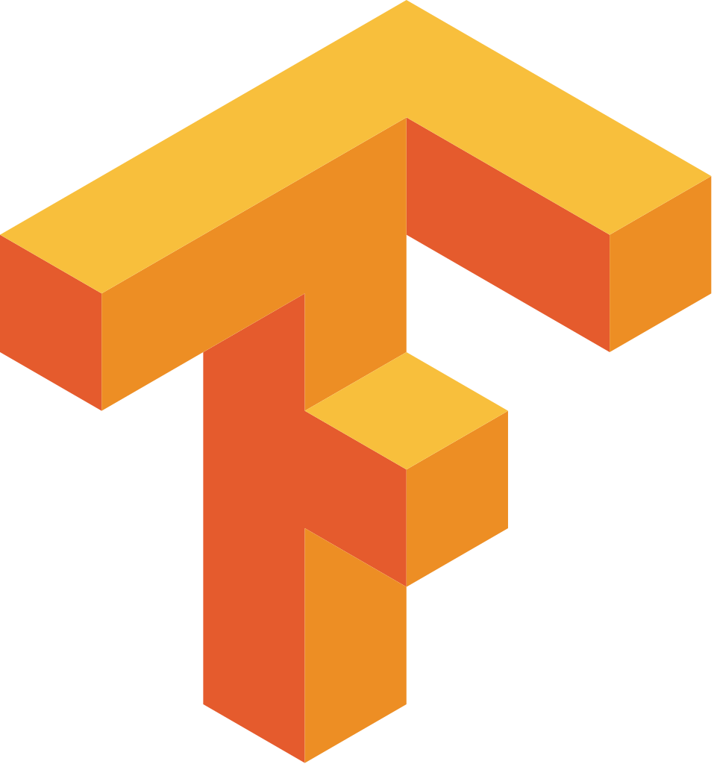
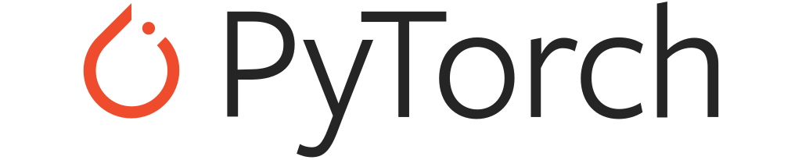


Which framework to choose?

Slide 12
Choose your first frameworks
Easy to learn.
Open-Source and well documented.
Coding style similar to what you have used before.
Have plenty of user-base so that you can get help whenever you get stuck.

Slide 13
Two famous frameworks
Tensorflow:
Free
Created by GoogleBrain
Mostly used for production
Not so Pythonic
Good userbase
PyTorch:
Free
Created by FAIR
Mostly used by Researchers
Pythonic
Good userbase

Slide 14
Now lets create our image classifier
https://colab.research.google.com/drive/1UemGOQY4oi8LZ_Ps2UIMThmulkmXR0V_

